Slide 1
Section 2.1
The Derivative: “Tangent Lines and Rates of Change”

Slide 2
All graphics are attributed to:
Calculus,10/E by Howard Anton, Irl Bivens, and Stephen Davis Copyright © 2009 by John Wiley & Sons, Inc. All rights reserved.

Slide 3
Introduction
Many real-world phenomena involve changing quantities-the speed of a rocket, the inflation of money (currency), the number of bacteria in a culture, the voltage of an electrical signal, etc.
A “derivative” is the mathematical tool for studying the rate at which one value changes relative to another.
Tangent lines relate this change to slope.

Slide 4
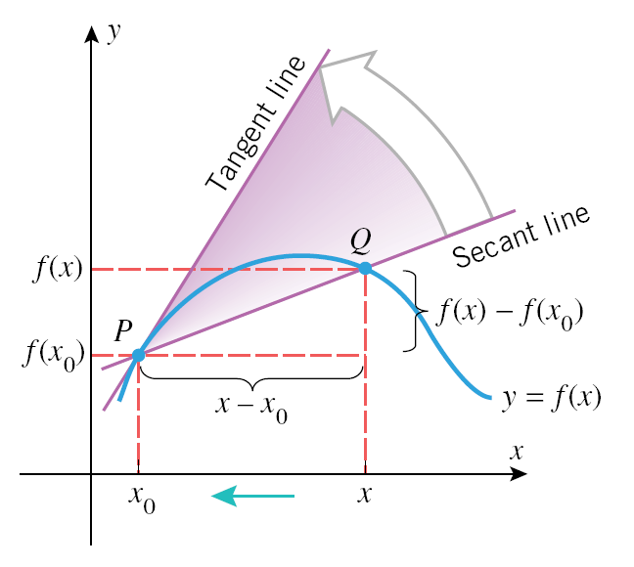
Secant Line vs. Tangent Line
As points P and Q on this graph get closer and closer together, the slope of the secant line through P and Q gets closer to the slope of the tangent line which is only at P.
From Geometry, a
secant line crosses
twice and a tangent
line touches once.

Slide 5
Slope of the Secant Line
The slope of the secant line comes from Algebra I, m = rise/run =
This book uses different notation, but it means the same thing.

Slide 6
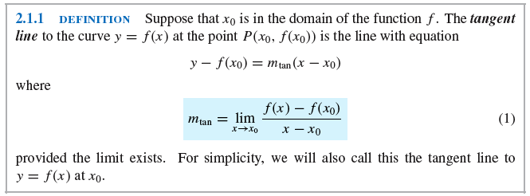
Slope of the Tangent Line
The slope of the tangent line is only through one point so we cannot use the same equation. Instead, we must calculate the limit as point Q approaches point P.

Slide 7
Velocity
One of the important themes in calculus is the study of motion. To describe motion we discuss speed and direction of travel which, together, comprise velocity.
For this section, we will only consider motion along a line (rectilinear motion).

Slide 8
Average Velocity Example

Slide 9
Instantaneous Velocity
Instead of an average, we often want to determine velocity at a specific instant in time. It is like finding the slope of the tangent line vs. finding the slope of the secant line.
We only have one time, so we cannot subtract. Instead, we must find the limit as we get closer and closer to the exact time we are looking for.

Slide 10
The Derivative Function
Derivatives are the primary mathematical tool that we use to study and calculate rates of change in a variety of different applications and can be used to calculate instantaneous rates of change.

Slide 11
Representations
There are several different formulas you can use which all look different and mean the same thing. Pick the one that you like best and stick with it.
This is the one we used last time:
Derivative =
Another option:

Slide 12
Example

Slide 13
Slope of the tangent line
You got the same result using any method for the derivative which is the slope of the tangent line for any value of x.
We can use it to find the slope at any given value of x:

Slide 14
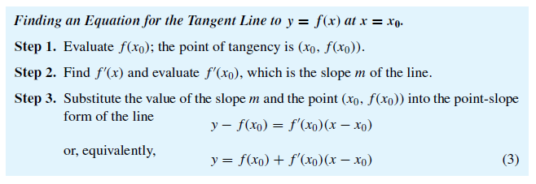
Equation for the Tangent Line
This looks intimidating, but it just means to use point slope form once you have the slope.

Slide 15
Previous example continued

Slide 16
Differentiability
It is possible that the limit that defines the derivative of a function may not exist at certain points in the domain of the function. When that happens, the derivative is undefined.

Slide 17
Differentiability Geometrically
Two common ways in which a function that is continuous can fail to be differentiable at certain values of x are when the following exist:
Corner points
Points of vertical tangency

Slide 18
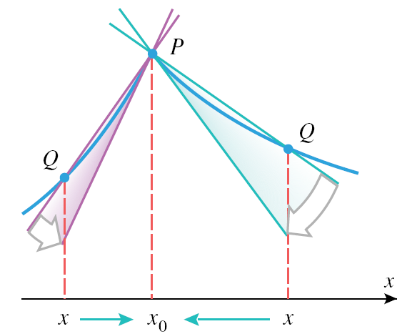
Corner Points
As you can see in the picture, the one sided limits of the slope of the secant line from the two sides of x₀ are not equal so the two sided limit does not exist.

Slide 19
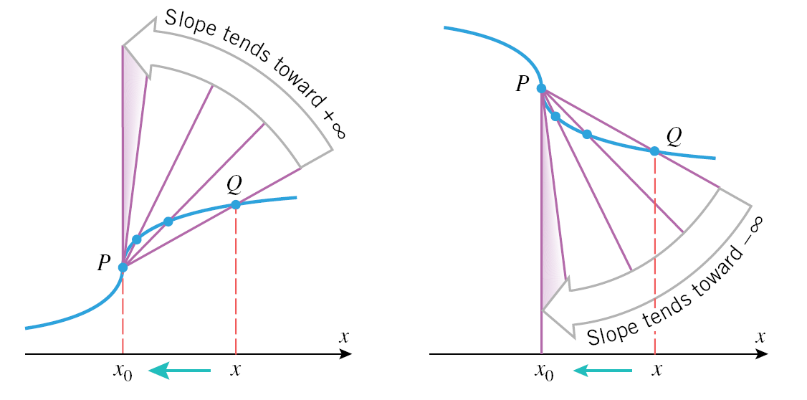
Points of Vertical Tangency
As you can see in the picture, the limits of the slope of the secant line approach +/- infinity which is not a measurable slope.

Slide 20
Points of Discontinuity
The previous two slides show that functions can be continuous at certain points where they are not differentiable (meaning you cannot take the derivative there).
It is also true that:
The proof is interesting, read about it and some related history on page 149.

Slide 21
Other Derivative Notations
We will talk more about these, but you should know that these mean the same thing:
Also, there are other formulas that some people use to find the derivative:
I tend to like the last one, but make your own choice.

Slide 22
The Derivative of a Constant
If you consider the graph of y=2 (for example), or y = any constant, it is a horizontal line whose slope is zero (see graph page 155 if you have a question).
Since the derivative of y=2 equals its slope, the derivative must be 0.
y’ = f’(x) = 0

Slide 23
Derivatives of Power Functions
We have taken the derivative of linear (x¹), quadratic (x²), and cubic (x³) functions in previous sections and talked about the “shortcut rule” or power rule.
There is a more formal proof in the middle of page 156.

Slide 24
Derivatives of Sums and Differences
We can use a proof very similar to the one on the previous slide (see page 158) to find the derivatives of sums and differences.
Which just means that the derivative of a sum/difference equals the sum/difference of the derivatives (as it did with limits).

Slide 25
Higher Derivatives
The second derivative is the derivative of the first derivative and all of the same rules apply.
As long as we have differentiability, we can continue the process of differentiating to obtain third, fourth, fifth, and higher derivatives of a given function.

Slide 26
Product Rule
We will learn a method for differentiating (taking the derivative of) products.
NOTE: The derivative of the product is NOT equal to the product of the derivatives. An example on the next page will show why.

Slide 27
Counter example
If we say that f(x) = x and g(x) = x² and we take their derivatives, we get that f’(x) = 1 and g’(x) = 2x by using the power rule on each function.
We would like to think that
[f(x) * g(x)]’ = f’(x) * g’(x)] WRONG
= 1 * 2x = 2x WRONG
It does not because f(x) * g(x) = x* x² = x³ which has a derivative of f’(x) = 3x² , NOT 2x.

Slide 28
The Product Rule

Slide 29
Proof

Slide 30
Shorter version of the Product Rule
Since addition is “commutative”, it does not matter what order you add in and 3+7 = 7+3.
When we get to the quotient rule, it has subtraction in it and subtraction is not commutative.
Therefore, I highly suggest you use the product rule in this form:
(f*g)’ = f’*g +g’ *f

Slide 31
Quotient Rule
Everything I wrote about where the product rule comes from and why also applies to the quotient rule.

Slide 32
Quotient Rule cont.
The proof is on pages 165-166.
The notation I like to use is:
(f/g)’ = f’g - g’f
g ²

Slide 33
Rules Summary

Slide 34
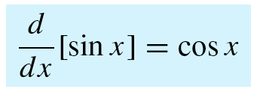
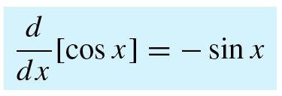
Derivatives of sin x, cos x, tan x
You can prove the derivatives of cos x and tan x similarly to the proof for sin x on the following slide.

Slide 35
Proof

Slide 36
Derivatives of csc x, sec x, cot x

Slide 37
Example

Slide 38
Derivatives of Compositions
The “Chain Rule” is the method we use when taking the derivative of a composition of functions f(g(x)).
y’ = dy/dx is obtained by a two-link “chain” of simpler derivatives

Slide 39
Example using
We will use an alternative version of the chain rule on a later slide to find the same derivative. Decide which method you prefer.

Slide 40
Alternative Version of the Chain Rule
can be frustrating during longer problems due to too many variables so you may want to use this instead.
They mean the same thing:

Slide 41
Example #1 using Alternative

Slide 42
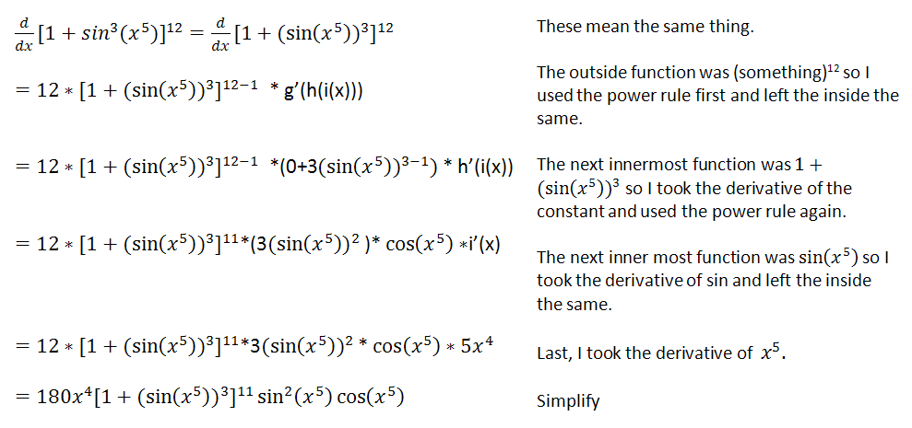
Chain Rule with Multiple Interior Functions
Make sure you only do one step at a time.

Slide 43
Encinitas Sunset

Slide 44
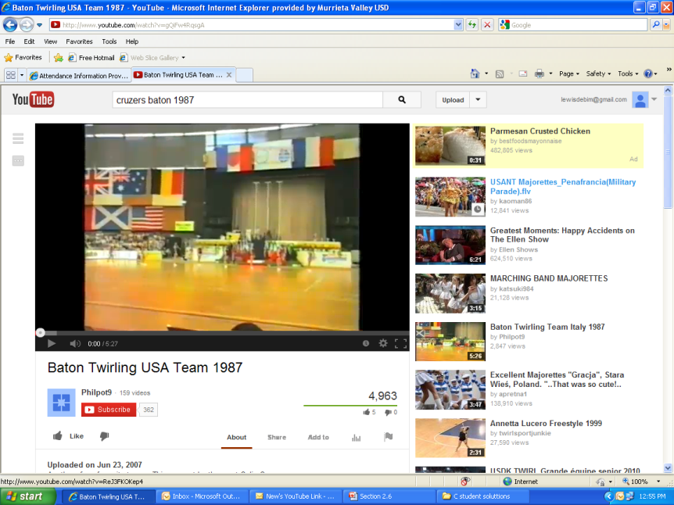
World Championships Paris, France 1987
If you go to YouTube and search Cruzers baton 1987, you should be able to find my team’s video from the world championships in Paris if you are interested. I am the really tall and white person towards the right. It looks like this:

